Slide 1
Introduction to Programming (II)
Artificial Intelligence: Searching (II)
楊舜仁

Slide 2
References
The Missionaries and Cannibals Problem
http://en.wikipedia.org/wiki/Missionaries_and_cannibals_problem
Online Game: http://www.novelgames.com/en/spgames/missionaries/
J.Glenn Brookshear "Computer Science - AN OVERVIEW", Addison-Wesley

Slide 3
Outline
The Missionaries and Cannibals Problem
The Eight-Puzzle problem
Solve OJ problems using C++ containers

Slide 4
Outline
The Missionaries and Cannibals Problem
The Eight-Puzzle problem
Solve OJ problems using C++ containers

Slide 5
Problem Description
Three missionaries and three cannibals must cross a river using a boat.
The boat can carry at most two people.
The boat cannot cross the river by itself with no people on board.
For both banks, if there are missionaries present on the bank, they cannot be outnumbered by cannibals (if they were, the cannibals would eat the missionaries).

Slide 6

How to solve this problem? (1/7)
One of the solutions is shown below.

Slide 7


How to solve this problem? (2/7)

Slide 8


How to solve this problem? (3/7)

Slide 9


How to solve this problem? (4/7)

Slide 10


How to solve this problem? (5/7)

Slide 11


How to solve this problem? (6/7)

Slide 12

How to solve this problem? (7/7)

Slide 13
The main function
int main()
{
vector<int> people = {3, 3};
Crossing p(people);
p.solve(15);
p.show_solutions();
}

Slide 14
Definition of class Crossing (1/2)
#include <iostream>
#include <vector>
#include <algorithm>
#include <set>
#include <list>
#include <iterator>
#include <string>
#include <sstream>
using namespace std;
using State = vector<int>;
class Crossing
{
private:
vector<int> _npeople;

Slide 15
Definition of class Crossing (2/2)
set<list<State>> _paths; // trial paths in progress
set<State> _explored; // explored states
set<list<State>> _solutions;
public:
Crossing(vector<int> np): _npeople {np} { }
State Go(State s, int missionary, int cannibal)
// check the validity of a state
bool valid(State s)
set<State> extend(State s)
// check if all people are at the right bank
bool found(State s)
void solve(int steps)
void show_solutions()
};//end class Crossing

Slide 16
How to describe a solution?
as a sequence of state transitions
How to represent a state?
as a 5-d vector
using State = vector<int>;
[# missionaries at the left bank, # cannibals at the left bank, # missionaries at the right bank,
# cannibals at the right bank, boat at left (=1) or right (=-1)]
Initial State: [3, 3, 0, 0, 1]

Slide 17
vector<int> _npeople;
// how many missionaries and cannibals
// we use vector<int> as a tuple (int, int)
// the first integer indicate the number of missionaries
// the second integer indicates the number of cannibals
//
// we will append another three components to _npeople // to create a 5-d state vector as mentioned earlier
set<list<State>> _paths; // trial paths in progress
set<State> _explored; // explored states
set<list<State>> _solutions;

Slide 18



State Go(State s, int missionary, int cannibal)
{
s[0] = s[0] - s[4]*missionary;
s[1] = s[1] - s[4]*cannibal;
s[2] = s[2] + s[4]*missionary;
s[3] = s[3] + s[4]*cannibal;
s[4] = -s[4];
return s;
}
s: [2, 2, 1, 1, 1]
ss = Go(s, 1, 1);
ss: [1, 1, 2, 2, -1]

Slide 19

set<State> extend(State s)
{
set<State> nextStates;
for (int m=0; m<=2; m++) {
for (int c=0; c<=2; c++) {
// a boat can take one or two people
if (m+c>=1 && m+c<=2) {
State ss = Go(s, m, c);
if (valid(ss))
nextStates.insert(ss);
}
}
}
return nextStates;
}

Slide 20
Outline
The Missionaries and Cannibals Problem
The Eight-Puzzle problem
Solve OJ problems using C++ containers

Slide 21
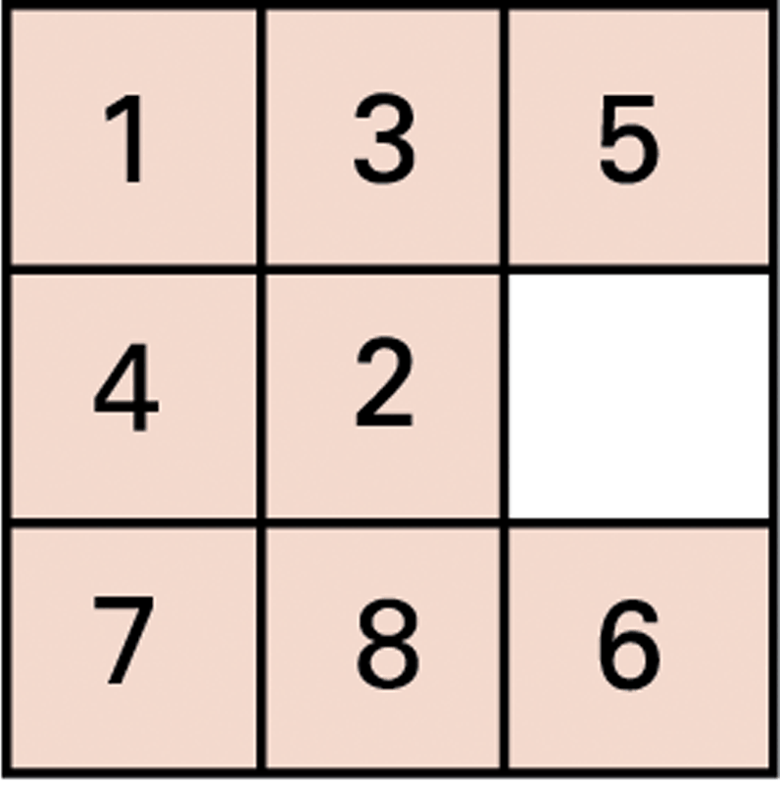
An unsolved eight-puzzle

Slide 22
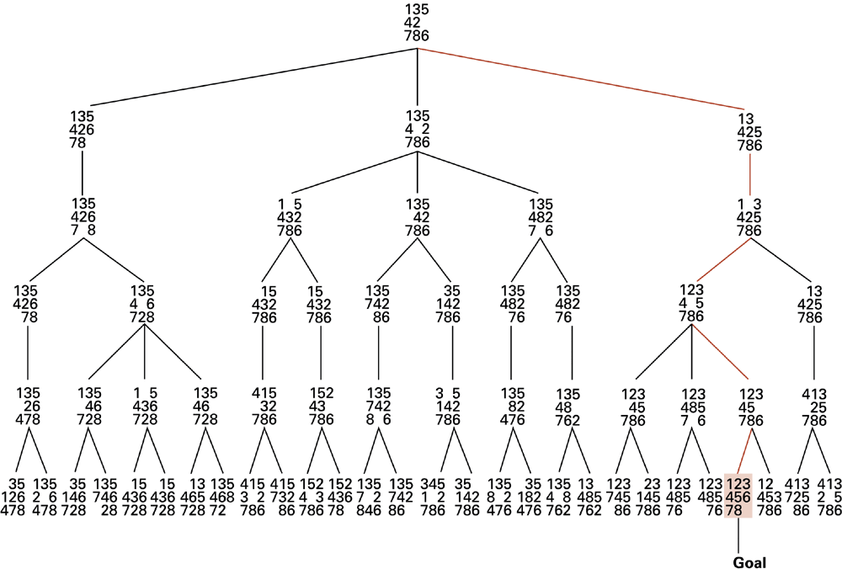
A sample search tree

Slide 23
Heuristic Strategies (1/3)
The search tree generated in an attempt to solve a more complex problem could grow much larger.
Developing a full search tree will be impractical
One strategy: change the order in which the search tree is constructed
Breadth-first: layer by layer
Depth-first: building the more promising paths rather than horizontal layers. (following intuition)

Slide 24
Heuristic Strategies (2/3)
Intuitive methods: need a way of identifying which of several states appears to be the most promising
Heuristic: A quantitative value associated with each state that estimates the distance to a goal

Slide 25
Heuristic Strategies (3/3)
Possible heuristics for the eight-puzzle
The number of tiles that are out of place + how far out of position
measure the distance each tile is from its destination and add these values to obtain a single quantity

Slide 26
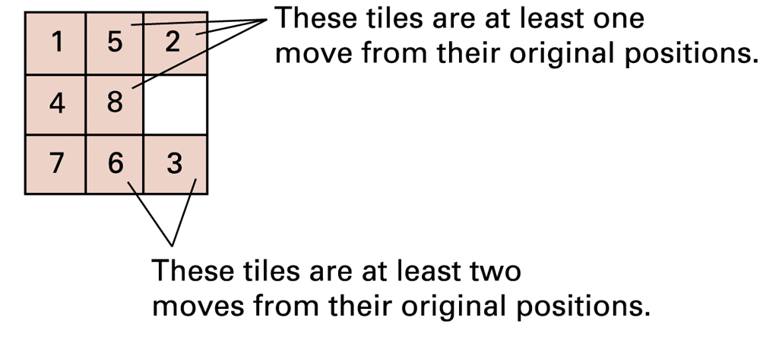
An unsolved eight-puzzle

Slide 27
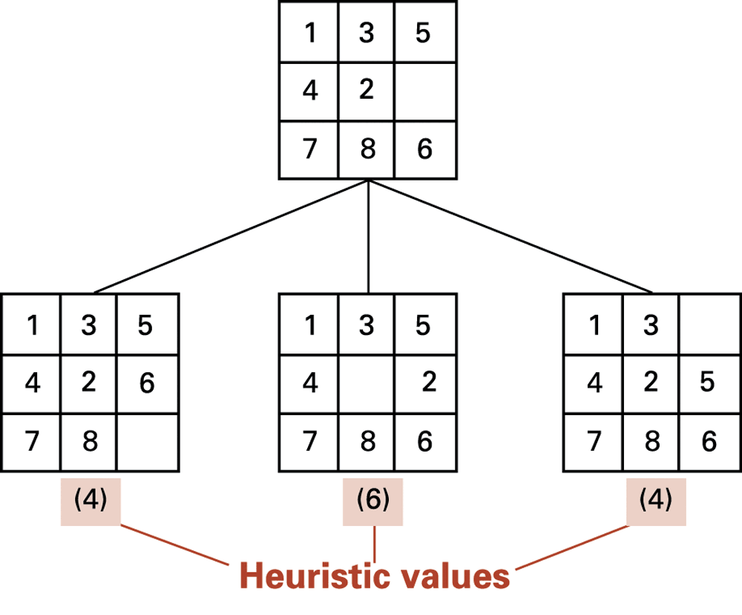
The beginnings of our heuristic search

Slide 28
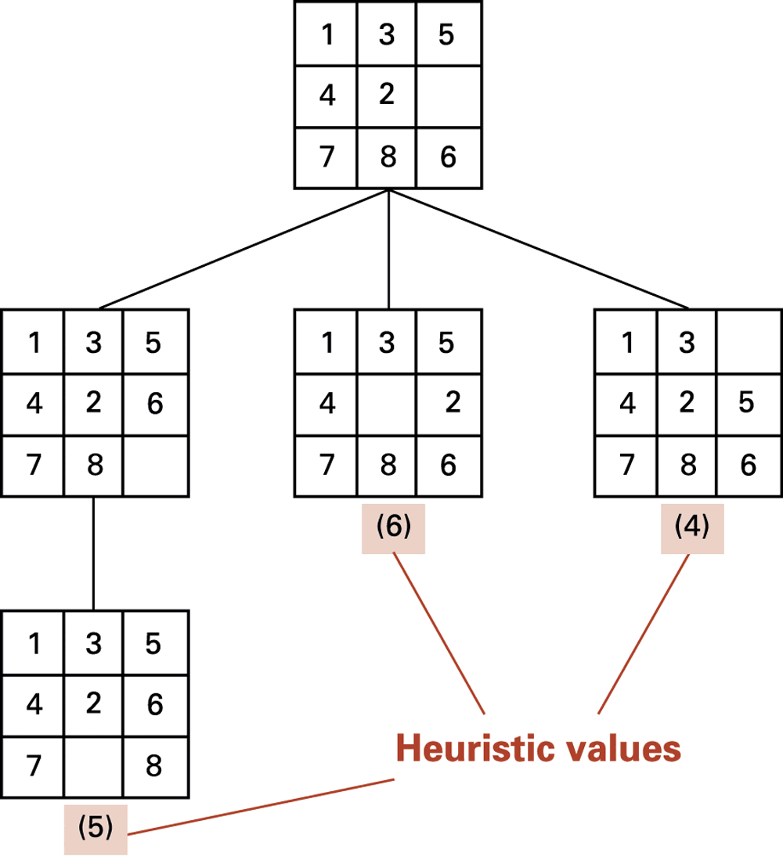
The search tree after two passes

Slide 29
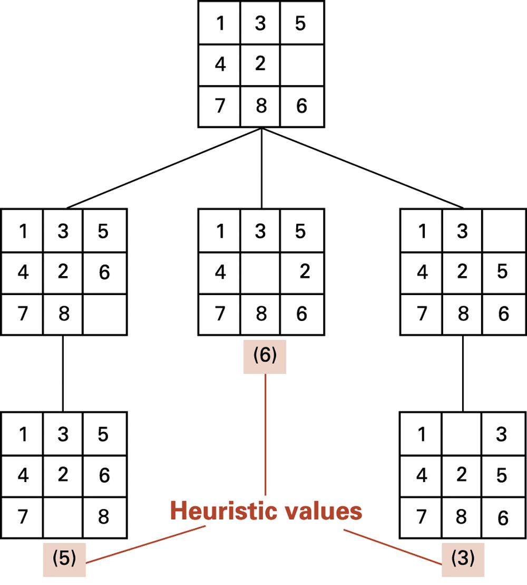
The search tree after three passes

Slide 30
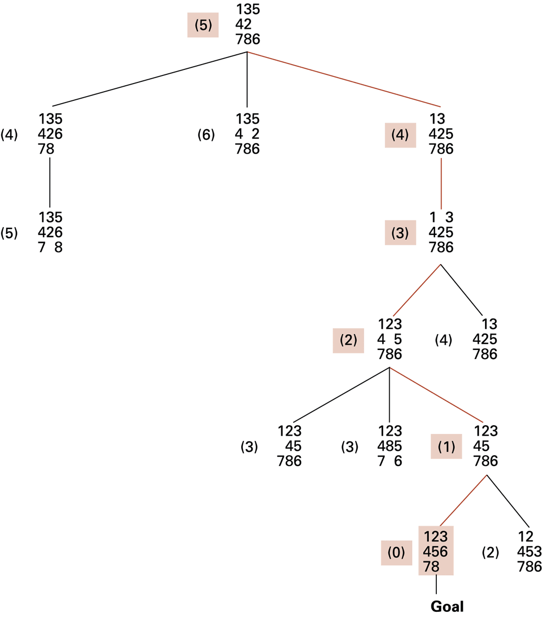
The complete search tree formed by our heuristic system

Slide 31
Outline
The Missionaries and Cannibals Problem
The Eight-Puzzle problem
Solve OJ problems using C++ containers

Slide 32
9328 - Queueing(I)
You need to write a program to simulate a queue of names.
Each name is a string consisting of English letters only.
There are three operations:
“Push [name]”, which means to enque name in the queue.
“Pop”, which means to deque. If the queue is empty, this operation takes no effect.
“Front”, which means to print out the name in the front of queue. If the queue is empty, print "empty" (without quotes).

Slide 33
Sample Input
Push Bruce Push Alan Front Pop Push Tom Pop Front Pop Pop Pop Front EOF

Slide 34
Sample Output
Bruce Tom empty EOF

Slide 35
#include <iostream>
#include <algorithm>
#include <queue>
#include <string>
// 9328 - Queueing
using namespace std;
int main()
{
string s;
queue<string> q;
while (cin >> s) {
if (s=="Push") {
cin >> s;
q.push(s);
}
else if (s=="Pop") {
if (q.size()>0)
q.pop();
} else if (s=="Front") {
if (q.size()==0)
cout << "empty\n";
else
cout << q.front() << "\n";
} else {
}
}
}

Slide 36
9467 - Parentheses Matching
A string is said to be valid if it matches one of the following rules:
The string is an empty string.
If a string S is valid, then {S}, [S], (S) and <S> are valid.
If strings S1 and S2 are both valid, then S1S2 is valid.
Given a string consisting of parentheses, determine if it is a valid string.

Slide 37
Sample Input
2 {[()]}() [(<})] EOF

Slide 38
Sample Output
Case 1: Yes Case 2: No EOF

Slide 39
#include <iostream>
#include <algorithm>
#include <map>
#include <stack>
#include <string>
// 9467 - Parentheses Matching
using namespace std;
map<char,char> parens =
{ { '{' , '}' },
{ '(' , ')' },
{ '<' , '>' },
{ '[' , ']' } };
int main()
{
string str;
int ncases;
cin >> ncases;
getline(cin, str);
for (int i=1; i<=ncases; i++) {
stack<char> S;
getline(cin, str);
bool valid = true;
for (char c : str) {
if (c=='{' || c=='[' || c=='(' || c=='<') {
S.push(c);
} else if (c=='}' || c==']' || c==')' || c=='>') {
if (S.empty()) {
valid = false;
break;
} else if (parens[S.top()] != c) {
valid = false;
break;
} else {
S.pop();
}
}
}//end for str

Slide 40
if (!S.empty()) {
valid = false;
}
cout << "Case " << i << ": ";
if (valid) {
cout << "Yes\n";
} else {
cout << "No\n";
}
}//end for ncases
}//end main

